Slide 1
Platforms
Lecture 4A: Microprocessor and Memory Basics

Slide 2
What is a microprocessor?
A microprocessor is the heart of a computer on a microchip.
Microprocessors are controlled by programs, which are simply lists of simple instructions.
Microprocessors are everywhere: in your mobile phone, your digital camera, your MP3 player, your USB drive, and your CD player - and in millions of personal computers around the world.
Microprocessors are small, flexible and cheap

Slide 3
Abstract system architecture
The Microprocessor itself consisting of:
an Arithmetic/Logic Unit (ALU) that performs mathematical and logical computations;
a Control Unit that manages the execution of instructions;
and multiple Registers that are used as temporary storage for instructions and data.
Memory, for both instructions and data
Input and Output ports which interface the processor to the external world, including keyboards, mice, monitors, disc drives, etc.

Slide 4
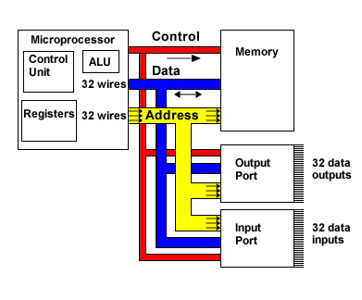
Abstract system architecture

Slide 5
Data, Address and Control Buses
The microprocessor, the memory and the input/output ports in isolation are interesting but an incomplete system.
They must be combined as a system of communicating components to be useful.
This communication is accomplished over bundles of signal wires (known as buses) that connect the parts of the system together.
There are normally three types of bus in any processor system.

Slide 6
Data, Address and Control Buses
An address bus: this determines the location in memory that the processor will read data from or write data to.
A data bus: this contains the contents that have been read from the memory location or are to be written into the memory location.
A control bus: this manages the information flow between components indicating whether the operation is a read or a write and ensuring that the operation happens at the right time.

Slide 7
Reading data from memory
Reading data from memory is also called "loading" data from memory into the processor.
1. Set the address (of the memory location) on the address bus.
2. Set the read/write wire of the control bus high (i.e. request a read operation).
3. Set the address valid control wire high.
4. The address valid signal, together with the value on the address bus will activate the chip select wire on the appropriate memory chip.

Slide 8
Reading data from memory
5. The contents of the memory location will now be placed on the data bus.
6. Read the value from the data bus - usually into a register in the microprocessor.
7. The read/write, address valid and chip select wires can now all be set low.
The read/write wire is usually labelled R / W

Slide 9
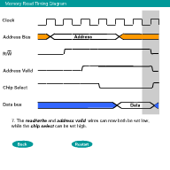
Reading data from memory

Slide 10
Writing data to memory
Writing data to memory is usually referred to as storing data to memory from the processor.
1. Set the address (of the memory location) on the address bus.
2. Set the read/write wire of the control bus low (i.e. request a write operation).
3. Set the address valid control wire high.
4. This address valid signal, together with the value on the address bus will activate the chip select wire on the appropriate memory chip.

Slide 11
Writing data to memory
5. Place the value to be stored onto the data bus.
6. The value on the data bus is then written into the correct memory location.
7. The read/write wire is now set high, while the address valid and chip select wires can now all be set low.
Each processor architecture varies in terms of the signal wire names and the exact timings when signals change.

Slide 12
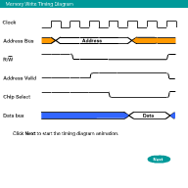
Writing data to memory

Slide 13
Memory Address Capacity
Let a = number of address wires and d = number of data wires.
a is the width of the address bus, while d is the width of the data bus.
In older computers, the address bus was 16 bits wide (a = 16). Such microprocessors could address up to 2¹⁶ = 65536 memory locations.
Increase the address bus width, increase number of locations addressable. One extra wire doubles capacity.

Slide 14
Memory Address Capacity
ARM processors have 32-bit or 64-bit wide address buses. A 32-bit processor could address 2³² = 4,294,967,296 memory locations!
In older computers, the data bus was 8 bits wide (d =8). Each location was an 8-bit byte.
Each byte stored either an unsigned number in the range 0-255 or a 2's-complement signed number in the range -128 to 127.
By increasing the number of data wires by one, the capacity goes up by 2ª bits.

Slide 15
Memory Address Capacity
ARM processors have 32-bit wide data buses. Each location is a word which is 4 bytes or 32 bits long.
Each word can store either an unsigned number in the range 0 to 4,294,967,295 or a 2's-complement signed number in the range -2,147,483,648 (-2³¹) to 2,147,483,647 (2³¹-1).
The total addressed capacity in bytes is: 2ª
For an ARM processor, the addressable capacity is 2³² bytes (or 4 Gigabytes of memory!)

Slide 16
Abstract system architecture

Slide 17
The Arithmetic and Logic Unit
The ALU performs most of the computation in a modern processor, including:
basic arithmetic (e.g. addition and subtraction)
comparison operations (such as testing for zero, negative numbers, etc.)
logical operations such as AND, OR, XOR (exclusive OR) and NOT (negation).
Many ARM processors include a coprocessor hardware unit
This handles more complex mathematical operations e.g. cosine, floating-point division

Slide 18
The Program Counter
The PC is a register inside the microprocessor that stores the memory address of the next instruction to be executed.
The PC is key to the fetch-decode-execute cycle.
The processor first fetches the instruction from the address stored in the PC.
The fetched instruction is then decoded so that it can be interpreted by the microprocessor.
Once decoded, the instruction is executed and the PC incremented so that it contains the address of the next instruction.

Slide 19
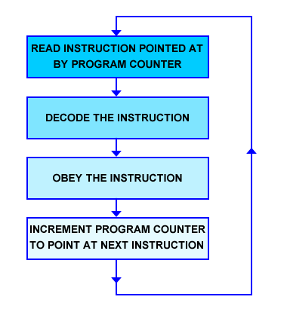
Fetch-Decode-Execute

Slide 20
The Program Counter
In ARM processors, the PC is a 32-bit register which is also known as R15.
In ARM processors, all instructions take up one word (4 bytes).
Incrementing the PC actually adds 4 to its value
ARM memory addresses are given in bytes but aligned on word boundaries.

Slide 21
Registers
Registers are used as temporary storage for instructions and data within the microprocessor.
In ARM processors:
Registers R0 to R14 are 32-bit general-purpose registers. These can be used by programmers for almost any purpose.
R15 is the Program Counter and is 32-bits wide.
The Current Program Status Register contains conditional flags and other status bits that reflect computational results, e.g. arithmetic overflows. It is 32 bits wide but only the first four and last eight bits are currently used.

Slide 22
Registers
The address register is an internal 32-bit register which can store either a future Program Counter address (so that the next instruction can be fetched in advance) or the address of a value (an operand needed for a computation).
The 32-bit data registers ("data in register" and "data out register") are used to hold data read from memory and data written to memory respectively.
Other processor architectures have specialized registers known as accumulators
These store intermediate arithmetic results and their assembly languages have commands to enable programmers to utilize them.

Slide 23
Memory Read and Write Operations
Memory chips (e.g. Random Access Memory) have address wires, data wires, the read/write (R / W) wire, and the chip select (CS) wire.
When CS is high, the memory chip does nothing.
When CS is low and R / W is low, the memory chip writes the data on the data bus into the location indicated by the address bus. The microprocessor can store data into memory.
When CS is low and R / W is high, the memory chip drives the data bus with the data from the location indicated by the address bus. The microprocessor can load data out of memory into registers.

Slide 24
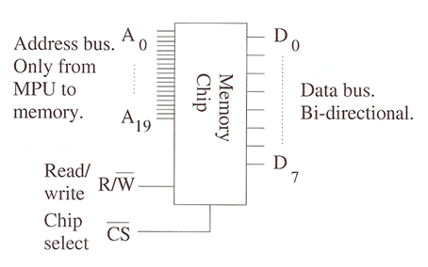
Calculating Storage Space

Slide 25
Calculating Storage Space
The example memory chip has 20 address wires (sometimes called address lines) and 8 data wires. It can therefore store 8 x 2²⁰ or 8,388,608 bits of information.
1 kilobinary byte = 2¹⁰ = 1024 bytes = 8192 bytes
1 megabinary byte = 2²⁰ = 1024 kilobytes = 1024 x 1024 bytes.
Kilobyte and megabyte are short for kilobinary byte and megabinary byte.
Hence the chip can store 1 Megabyte of data.

Slide 26
Calculating Storage Space
Each bit inside the chip has its own memory element, which can be set low (0) or high (1).
These are arranged as a matrix of rows and columns.
There is one row of memory elements for each address and one column for each data wire.
Address bus signals are passed to a decoder:
It determines which row of memory elements corresponds to the address on the bus.
By selecting one row out of 2^{n} possibilities where n is the number of address lines feeding in from the bus.

Slide 27
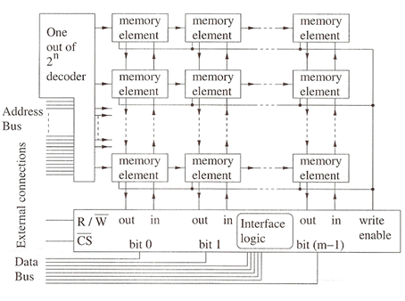
Memory Elements Array

Slide 28
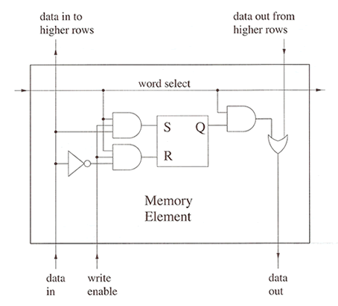
Address Decoders
The word select lines are driven from the "one out of 2^{n} decoder".
Thus only one word select line is driven high at any time.

Slide 29
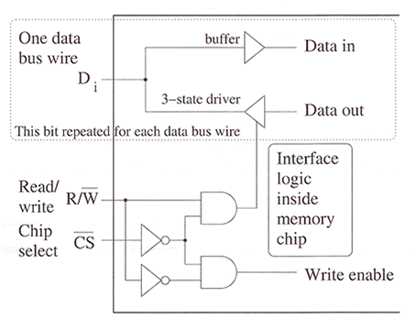
Address Decoder
The diagram shows how the internal signals data in, data out, and write enable are connected to the external data bus wires, the read/write wire and chip select.

Slide 30
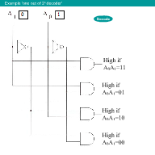
Address Decoders

Slide 31
Address Decoders
If address decoding was performed by a single decoder, it would be a massive block of circuitry.
Most architectures use a hierarchy of decoders to break the problem down into more manageable pieces.
Usually the last stage of decoding (e.g. determining which of the 2²⁰ locations on the chip is required) is performed inside the memory chip itself.

Slide 32
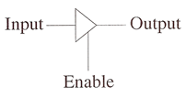
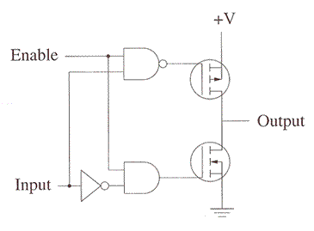
Tri-state Buffers
When enable is low, neither transistor is on and the output is not connected to any voltage by this part of the circuit.

Slide 33
Multiple Memory Chips
Our memory chip with its 20 address wires contains 2²⁰ locations. If the chip has 8 data lines, then each location can hold a byte.
An ARM microprocessor has 32 address wires so it can address up to 2³² locations.
To fill the ARM microprocessor address space with such memory chips you would need:
2³² / 2²⁰ = 2¹² = 4096 chips (4 Gigabytes)

Slide 34
Multiple Memory Chips
The ARM address space is from 00000000_{H} to FFFFFFFF_{H}.
A single 1 megabyte memory chip contains 2²⁰ = 100000_{H} addresses
Therefore we need to wire one memory chip such that it responds to addresses 00000000_{H} to 000FFFFF_{H} and the next chip so it responds to addresses 00100000_{H} to 001FFFFF_{H} and so forth.

Slide 35
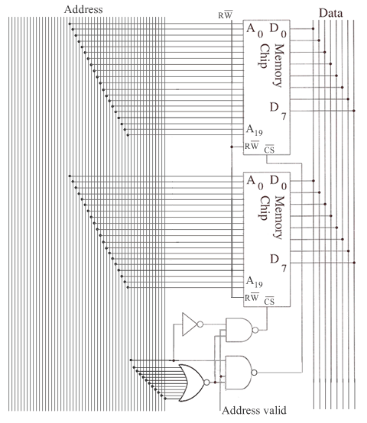

Slide 36
Other Types of Memory
RAM Random Access Memory.
It is readable and writeable, but normally "forgets" when the power is switched off.
There are two main types of RAM in use, SRAM and DRAM
SRAM is Static RAM, which has:
a simple interface, good storage density, speedy access and low power consumption (when not in active use).
used for fast cache memories on PC motherboards and mobile phone memories

Slide 37
Other Types of Memory
DRAM Dynamic RAM
has a complex interface because it must have its contents refreshed continuously (as it "forgets" in milliseconds)
consumes power even when not in use
is slower than SRAM.
provides very dense storage
frequently used as PC main memory

Slide 38
Other Types of Memory
ROM Read Only Memory.
ROM contents are set at manufacture time
can never be changed by the microprocessor.
EPROM Erasable Programmable Read Only Memory.
can be programmed using a device that uses higher voltages than in a normal microprocessor circuit.
EPROMs cannot be altered by the microprocessor.
can be erased either using UV light through a small window on the top, or by applying a higher voltage again (EEPROMs Electrically Erasable PROMS).

Slide 39
Other Types of Memory
Most ROMs today are programmable
They include the bootstrap memory of a PC, "memory sticks" and the SIM cards of mobile phones.
More long-term storage is achieved through the use of magnetic disks (the hard drive of personal computers), CDROMs, and DVDs.

Slide 40
Memory Mapped Input/Output
We want to create input and output ports that each appear to the microprocessor just like a location in memory.
This will enable the microprocessor to interact with the outside world.
We could then arrange that every byte read from the input port was a character read from the keyboard, and every byte written appeared as a character on the monitor screen.

Slide 41
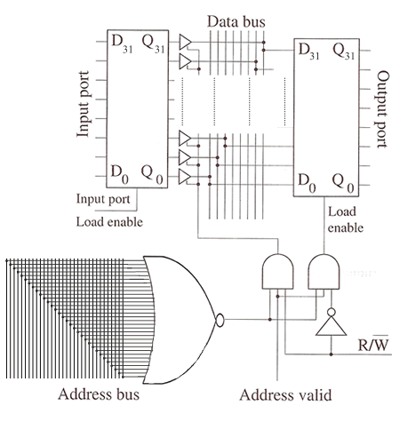
Memory Mapped Input/Output

Slide 42
Memory Mapped Input/Output
The diagram shows an input port and an output port both mapped to memory location 00000000_{H}.
Reading from location 00000000_{H} reads from the input port.
Writing to 00000000_{H} writes to the output port.
If the microprocessor writes a number to location 00000000_{H} and then reads location 00000000_{H} back, it will not necessarily get the same number!

